Slide 1
Scriptie
Jort Siemes
08-01-2025

Slide 2
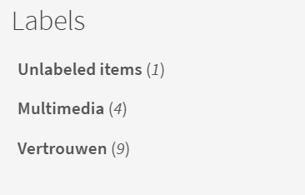
Literatuur
Vertrouwen in Journalistiek
Onderzoek naar:
“multimedia & immersive longform”

Slide 3
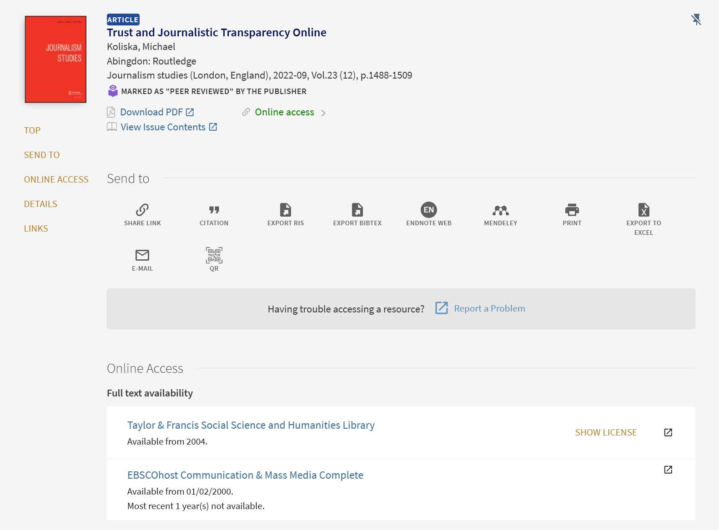
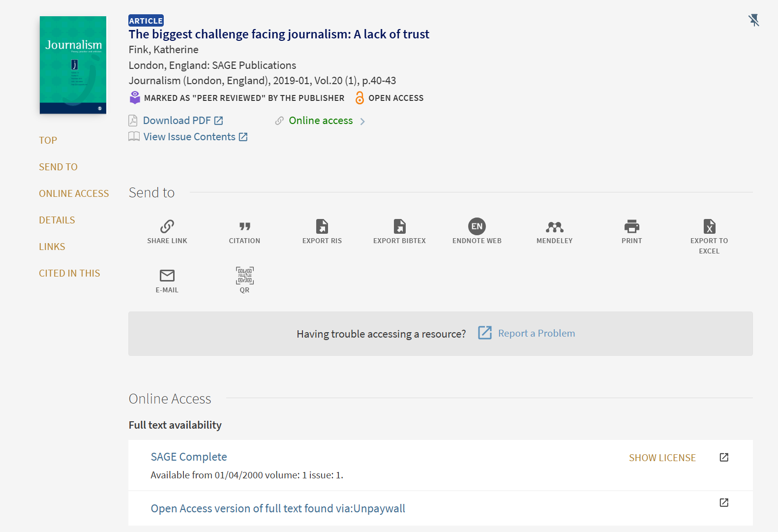
Vertrouwen in Journalistiek

Slide 4
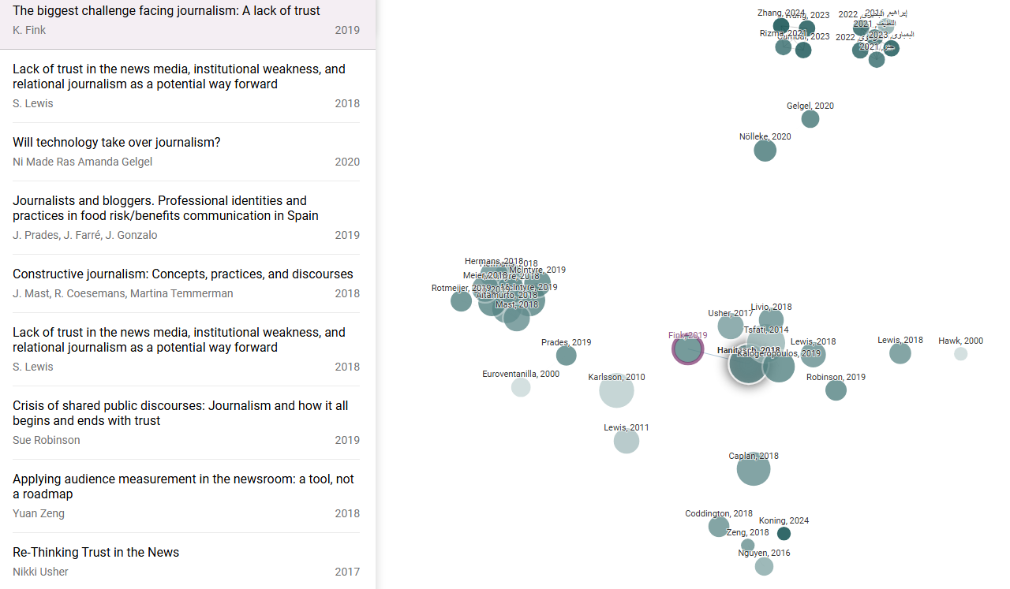
Vertrouwen in Journalistiek

Slide 5
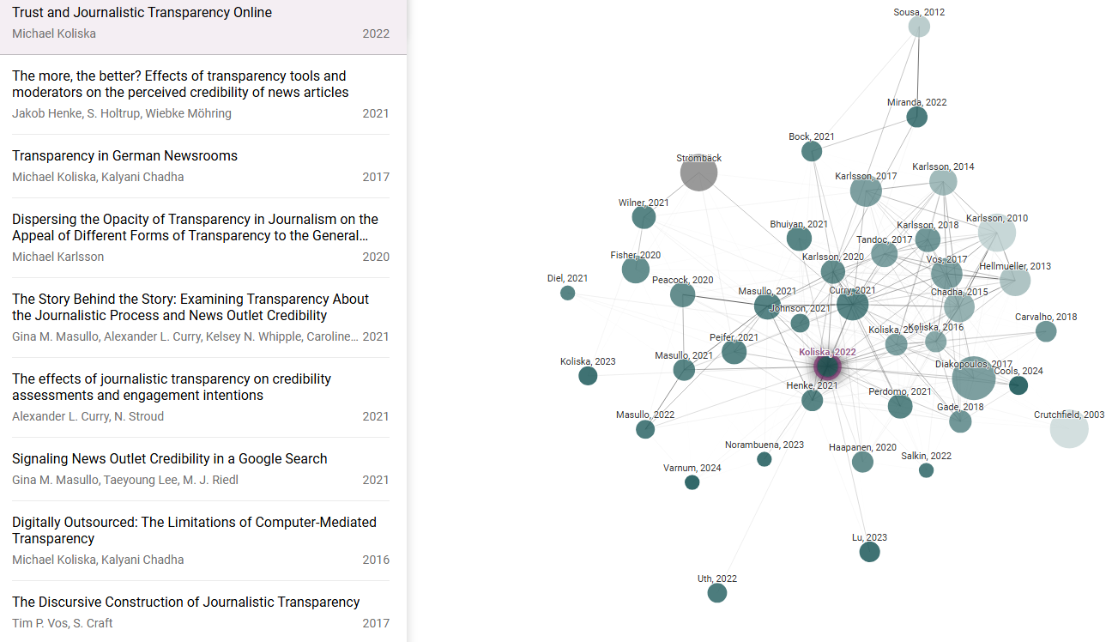
Vertrouwen in Journalistiek

Slide 6
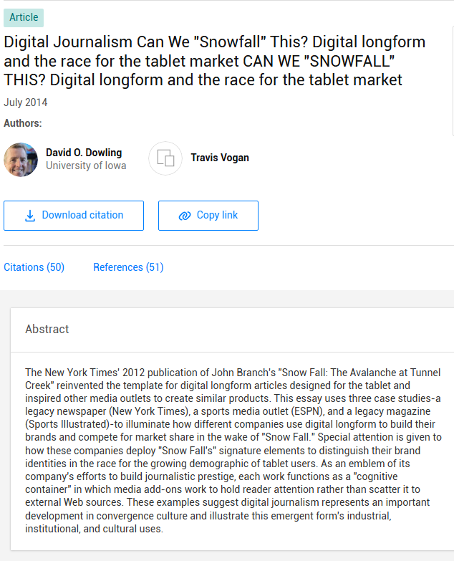
Onderzoek naar:
“multimedia & immersive longform”
"Snow Fall: The Avalanche at Tunnel Creek," is a New York Times multimedia feature by reporter John Branch about the 2012 Tunnel Creek avalanche, published on December 20, 2012. The article won the 2013 Pulitzer Prize in Feature Writing and a Peabody Award.^{[1]} Packaged together as a six-part story interwoven with interactive graphics, animated simulations and aerial video, "Snow Fall" became one of the most talked about online news articles in 2013 and garnered praise and debate over it being an example of "the future of online journalism."^{[2]} The article became highly influential among online journalism circles, with many other publications attempting similar multimedia features and even coined an industry term, "to snowfall."^{[3]}

Slide 7
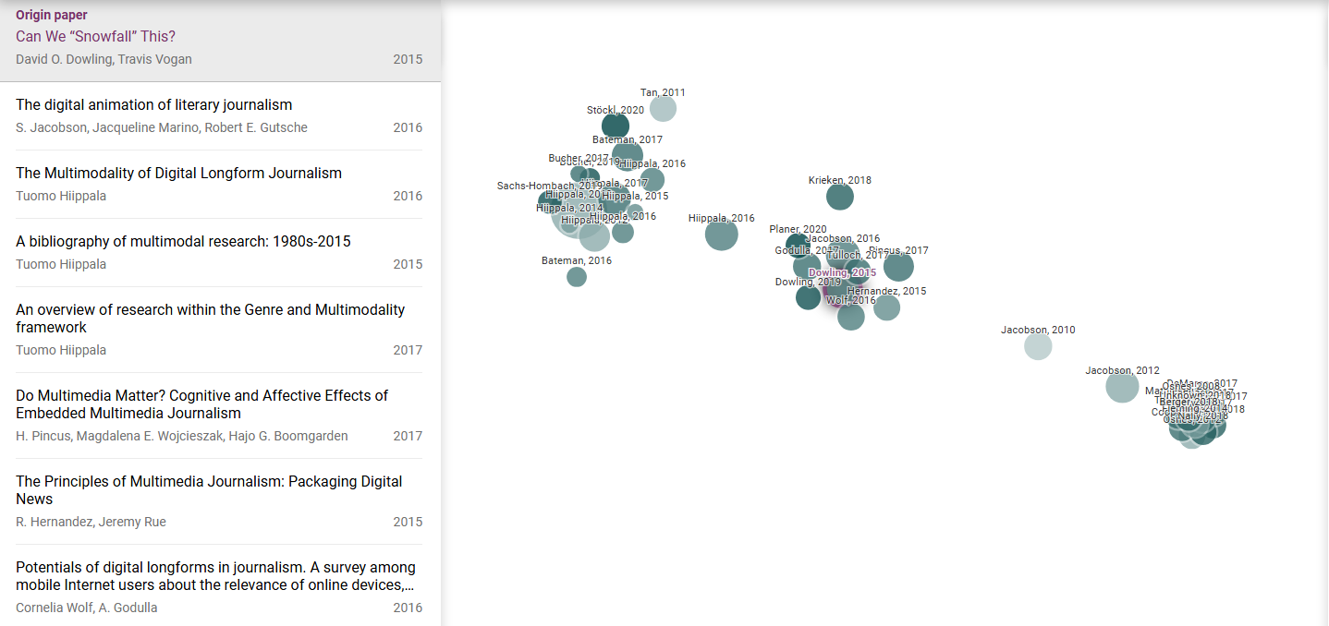
Onderzoek naar:
“multimedia & immersive longform”

Slide 8
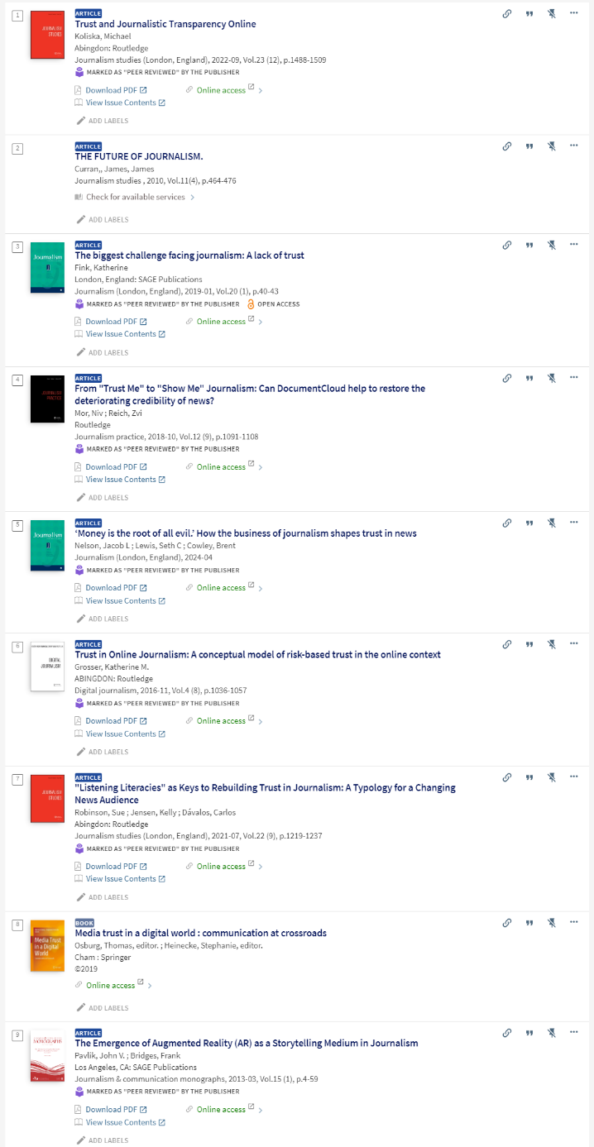
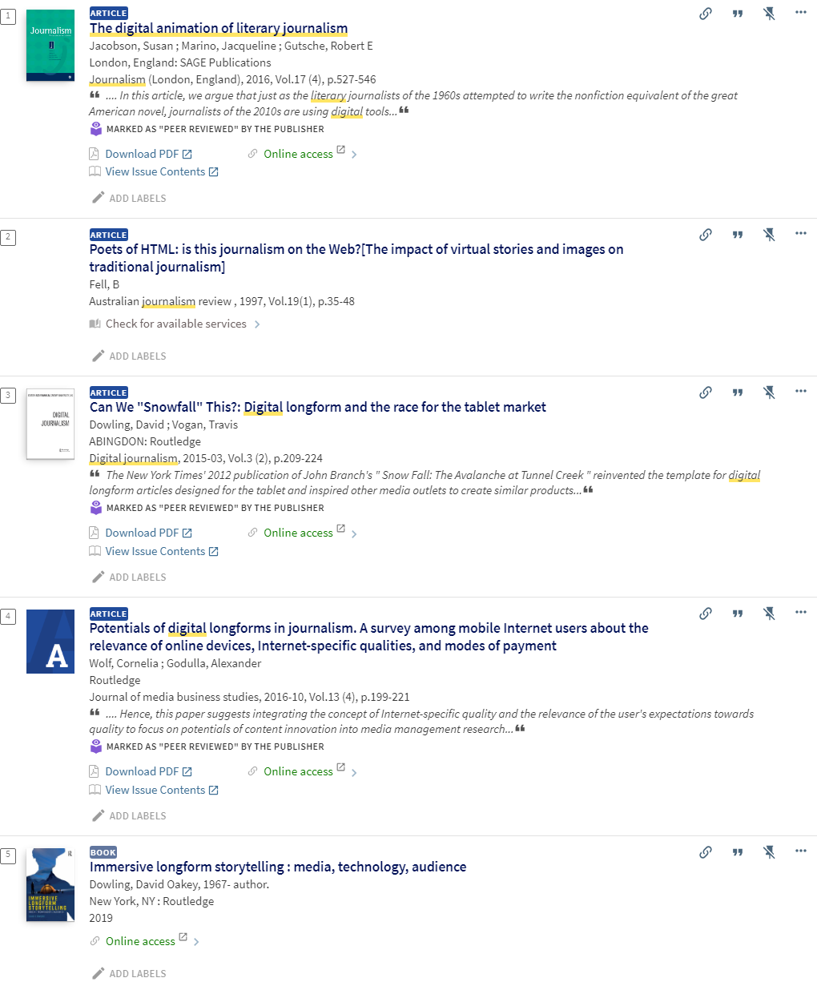
Leeslijst

Slide 9
Keywords
Multimedia
CMS: Content Management System
embedded multimedia
Trust (Restoring trust)

Slide 10

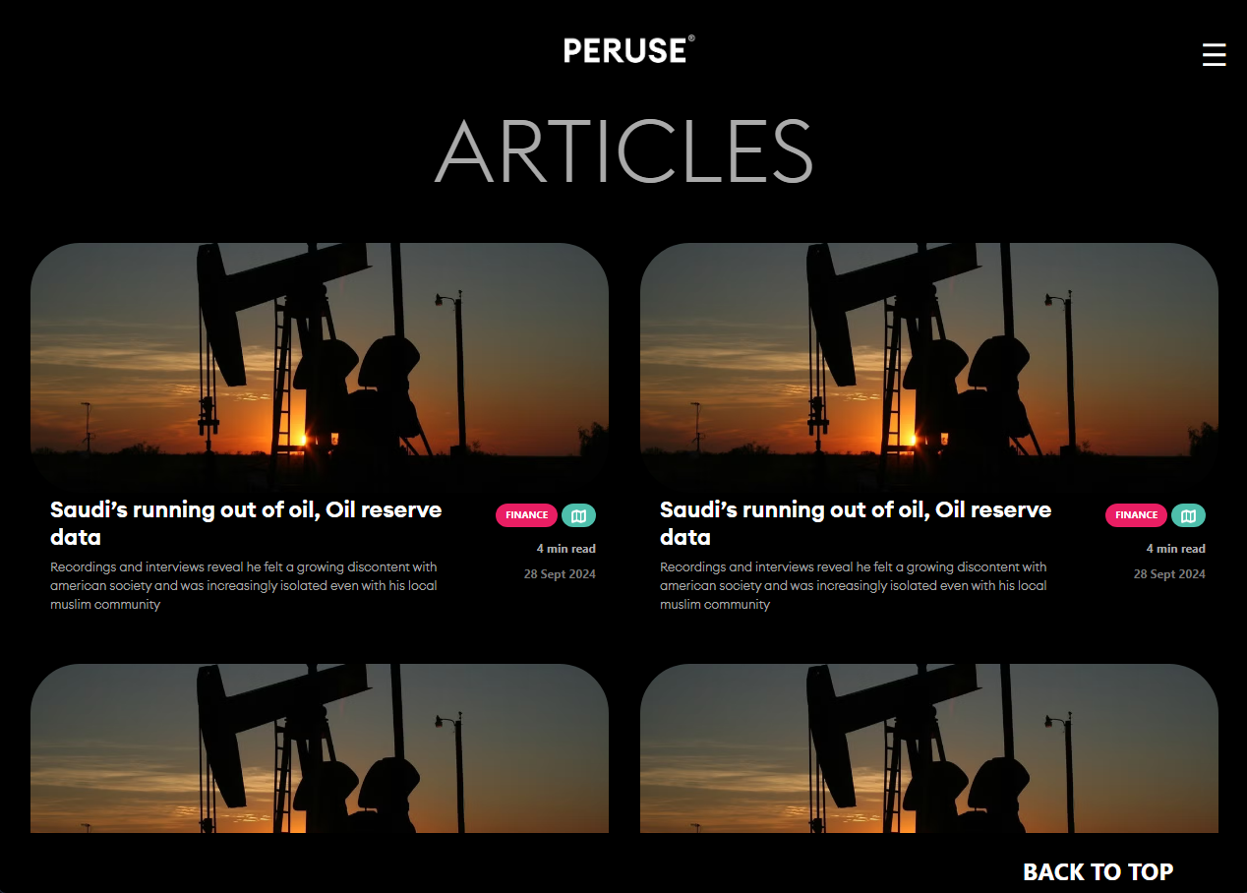
Website haalbaarheid
Jortfolio.nl/html/peruse
Mobile
Web

Slide 11
